Slide 1
Effect of variations on protein structure
Variation

Slide 2

Single nucleotide polymorphism
SNPs result from the substitution of a single base-pair.
Transversion event substituting a
Thymine nucleic acid in place of a Guanine.

Slide 3
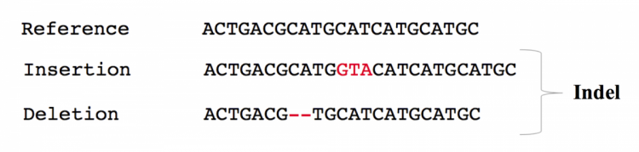
Indels
Indels affect a string of base-pairs.
GTA has been inserted
CA has been deleted

Slide 4
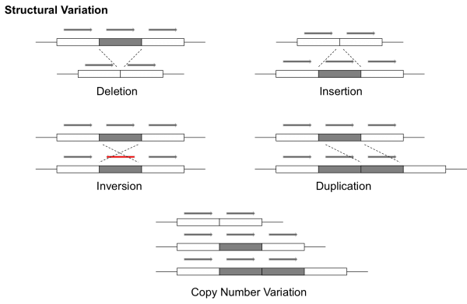
Structural variation

Slide 5
Vocabulary
Synonymous change – no change in aa seq
GCT and GCC code for alanine
May affect translation due to different codon usage and rarity of some tRNAs
Nonsense – coding codon to stop codon
GGA glycine to TGA stop codon
Truncated protein – usually nonsense mediated decay
Missense – change in aa seq
ACC threonine to AAC asparagine

Slide 6
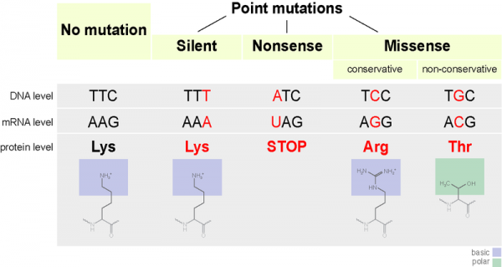

Slide 7
Proteins must
Fold correctly
Be stable (but not too stable)
Bind to other proteins or ligands in the cell
Have a functional catalytic site
Assemble correctly (oligomerization)

Slide 8
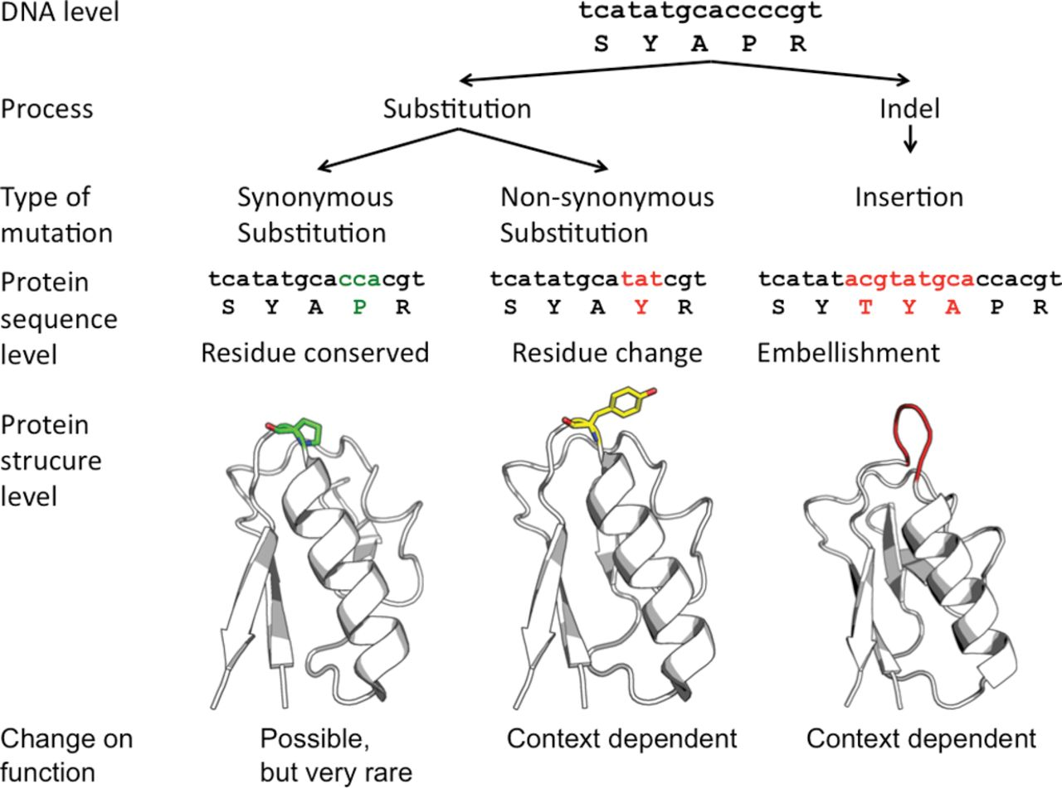

Possible effects of mutations on proteins Various mutational processes can affect proteins.
Romain A. Studer et al. Biochem. J. 2013;449:581-594
©2013 by Portland Press Ltd
Notes:
Possible effects of mutations on proteins Various mutational processes can affect proteins. The first case is when a synonymous mutation occurs, keeping the protein sequence unchanged. In the majority of cases, these types of mutations will not affect the protein. However, the structure and function could be affected by a defect in the translation process, owing to different codon usage and the rarity of some tRNAs [195]. The second case is when the protein sequence is changed by a non-synonymous mutation. The mutation could have no impact (i.e. amino acids with similar biochemical properties), could have a potential effect, weak or strong (i.e. effect on folding, binding and enzyme catalysis) or damage the protein structure by affecting the stability. The final case is when a block of sites is inserted or deleted (indels). Again, this could have an effect or not, depending on the context. The probability of fixation of these mutations in the genome depends on different factors, such as the population size or the beneficial effect of the mutation on the organismal fitness.

Slide 9
Effect of variations on protein structure
Protein Structures

Slide 10
Protein Structure
Why protein structure?
The basics of protein sequence structure
Levels of protein structure
Sequence and structure
Conservation and variation
Classification of protein structures

Slide 11

Why protein structure?
In the factory of living cells, proteins are the workers, performing a variety of biological tasks.
Each protein has a particular 3-D structure that determines its function.
Protein structure is more conserved than protein sequence, and more closely related to function.

Slide 12
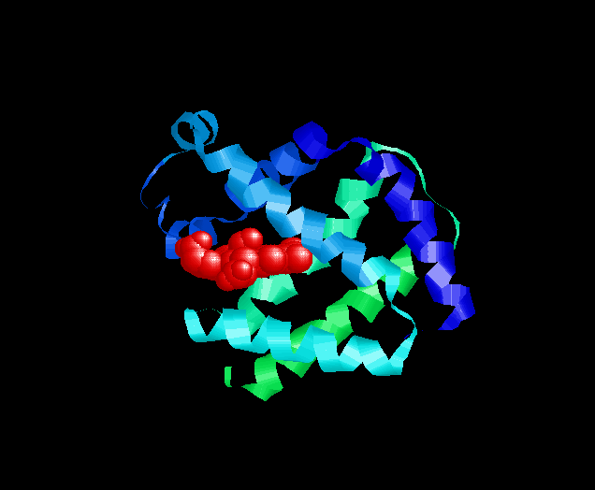
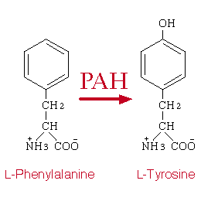
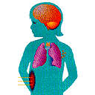
Central Paradigm of Bioinformatics
Genetic
Information
Molecular
Structure
Biochemical
Function
Phenotype
(Symptoms)
MVHLTPEEKT AVNALWGKVN VDAVGGEALG RLLVVYPWTQ RFFESFGDLS SPDAVMGNPK
VKAHGKKVLG AFSDGLAHLD NLKGTFSQLS ELHCDKLHVD PENFRLLGNV LVCVLARNFG
KEFTPQMQAA YQKVVAGVAN ALAHKYH

Slide 14
Some basic information
Proteins are linear heteropolymers: one or more polypeptide chains
Building blocks: 20 types of amino acids.
Range from a few 10s-1000s aa
Three-dimensional shapes (“fold”) adopted vary enormously.

Slide 15
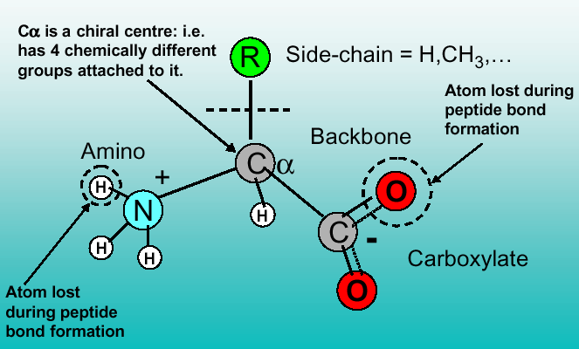
Common structure of Amino Acid

Slide 16
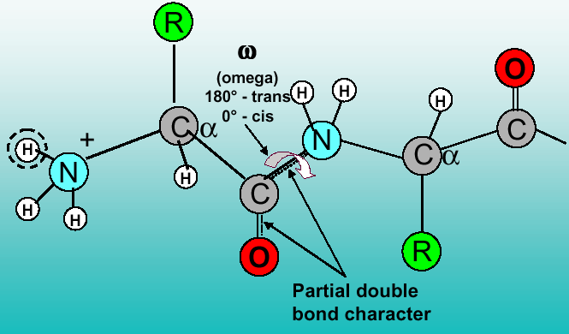
Formation of polypeptide chain

Slide 17
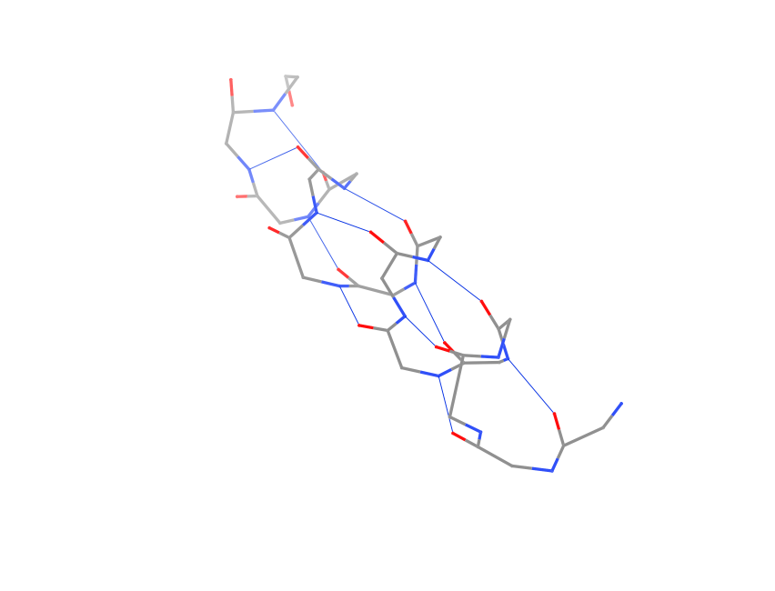
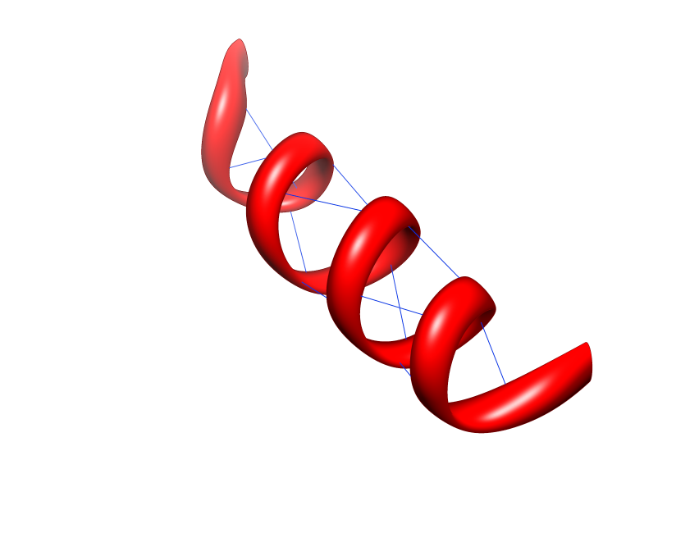
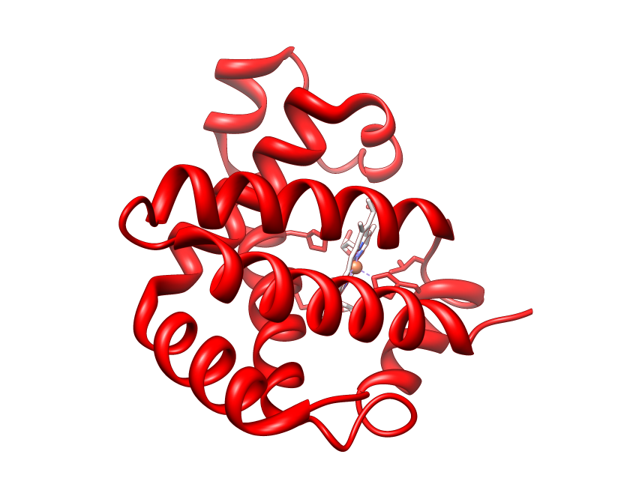
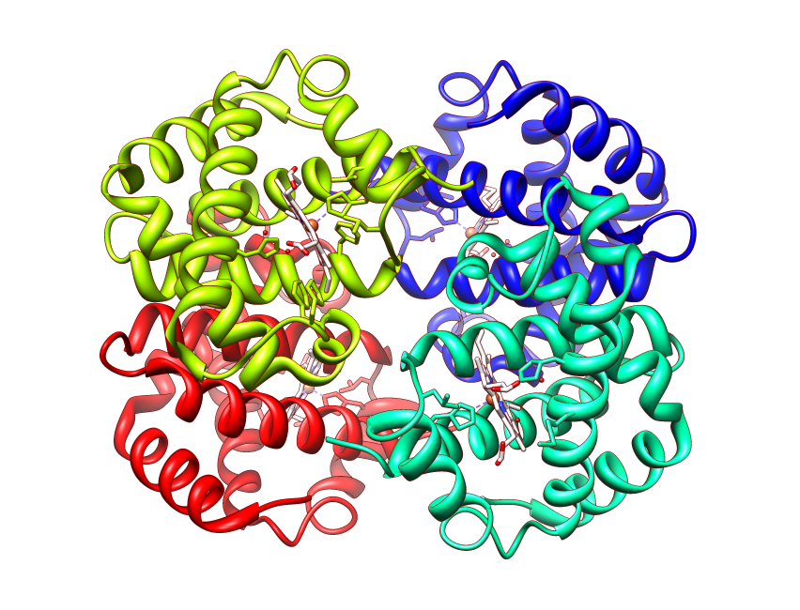
Four Levels of Protein Structure
Primary, 1º
TPEEKSAVTALWGKV
Secondary, 2º
Tertiary, 3º
Quaternary, 4º
α2
α1
β2
β2
β1
Notes:
All images from 4hhb

Slide 18
Primary structure
This is simply the amino acid sequences of polypeptides chains (proteins).

Slide 19
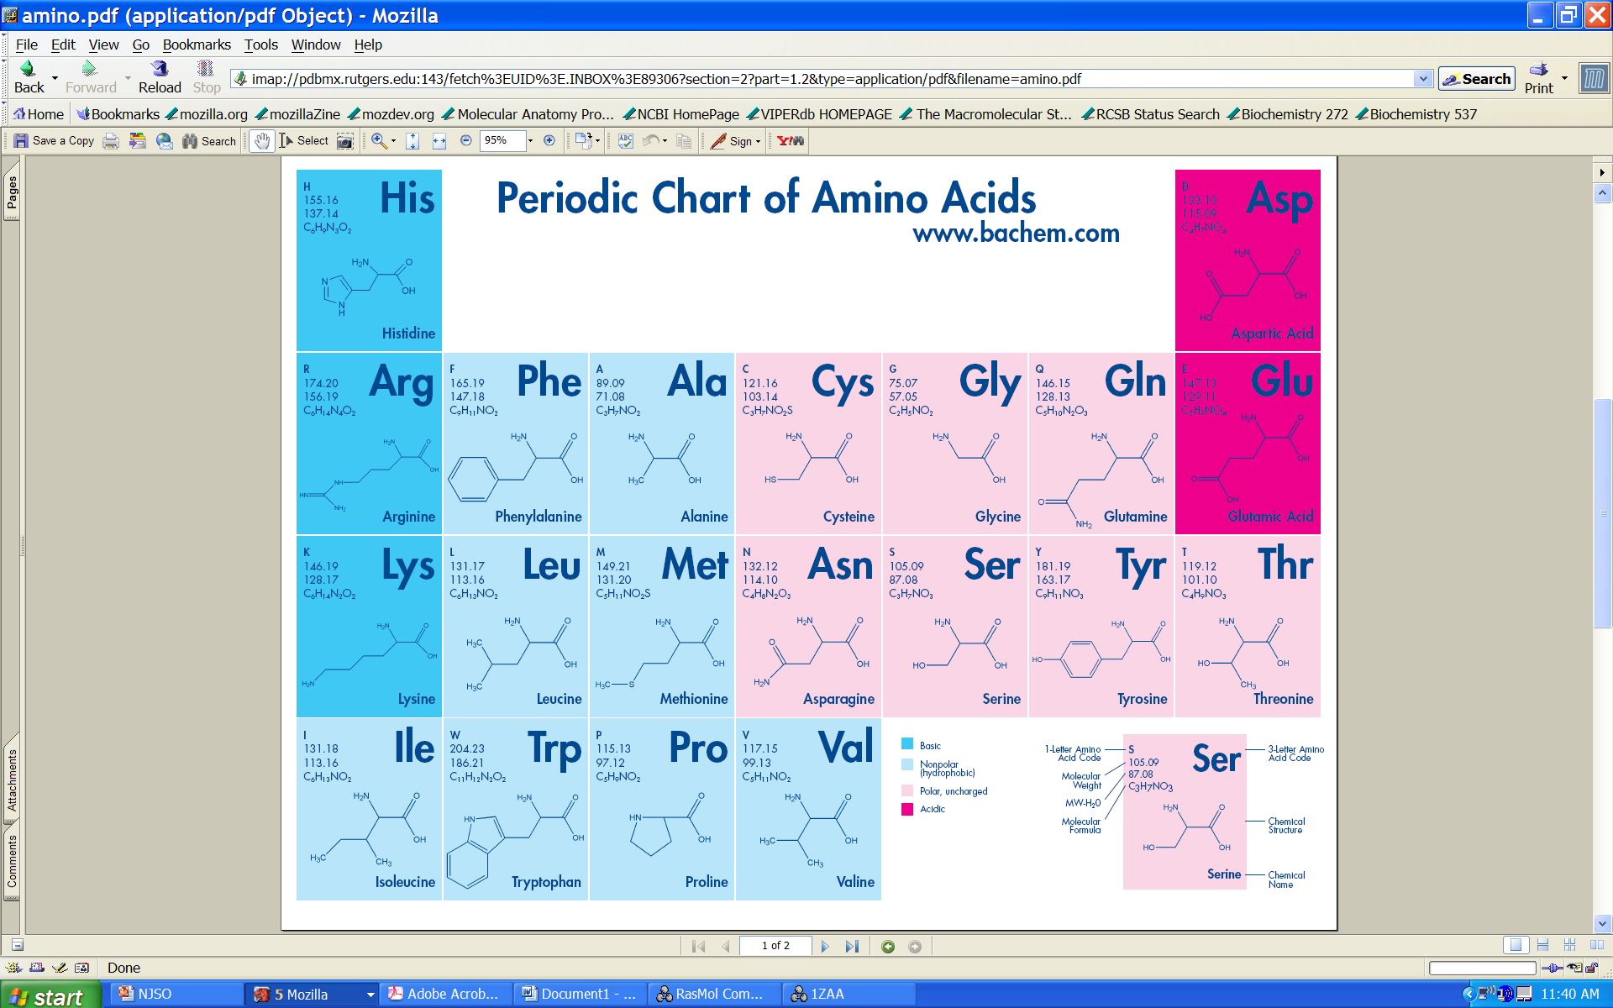
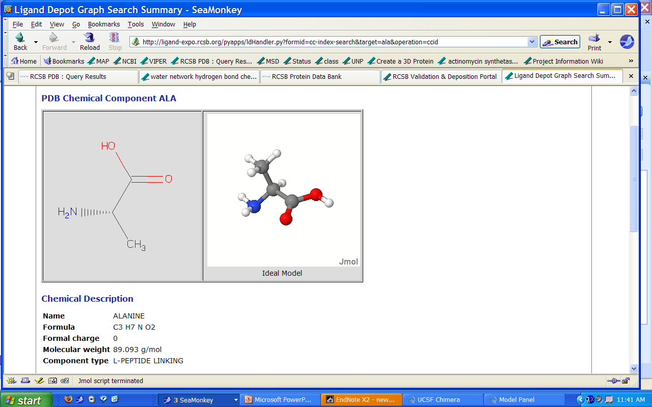
Protein Building Blocks: Amino Acids
Basic
Acidic
Hydrophobic
Hydrophilic
Side chain
C-alpha
Amino
group
Carboxyl
group
From www.bachem.com

Slide 20
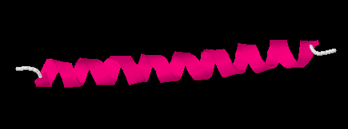
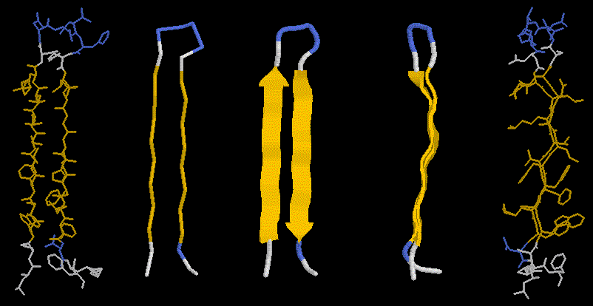
Secondary structure
Local organization of protein backbone: α-helix, β-strand (groups of β-strands assemble into β-sheet), turn and interconnecting loop.
an α-helix
various representations and
orientations of a two stranded
β-sheet.

Slide 21
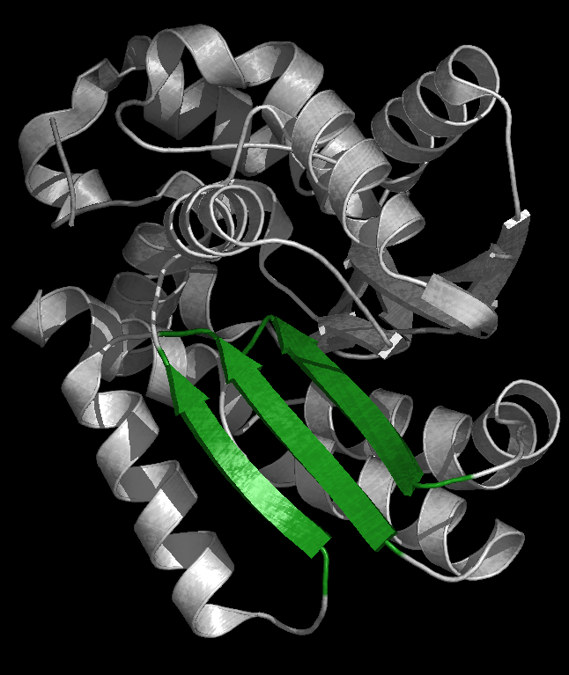
β-Sheet (parallel)
Catechol O-Methyltransferase
All strands run in the same direction

Slide 22
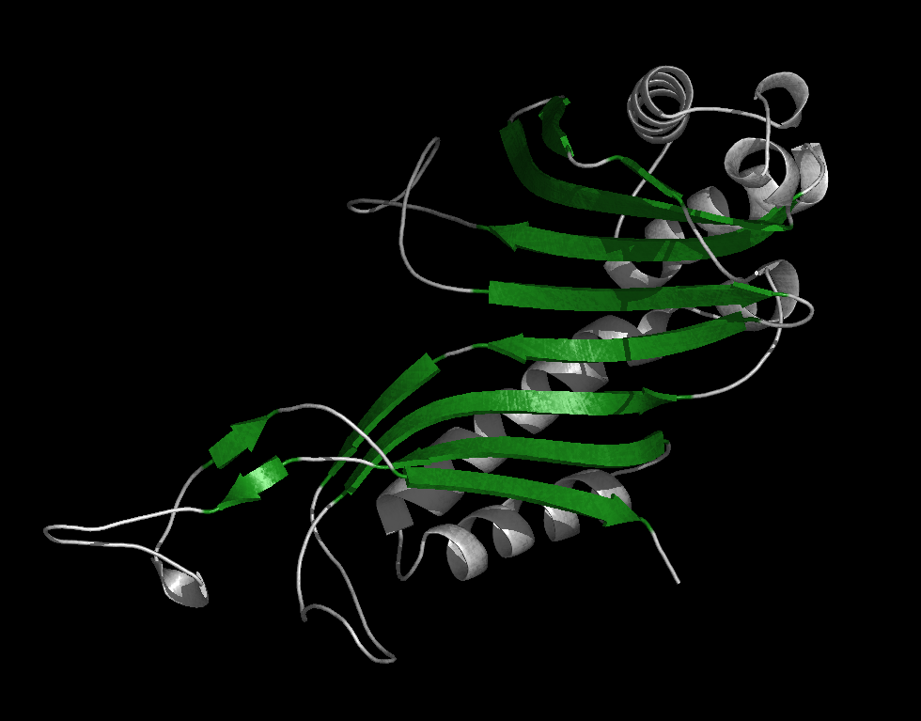
β-Sheet (antiparallel)
Urate oxidase
All strands run in the opposite direction, more stable

Slide 23
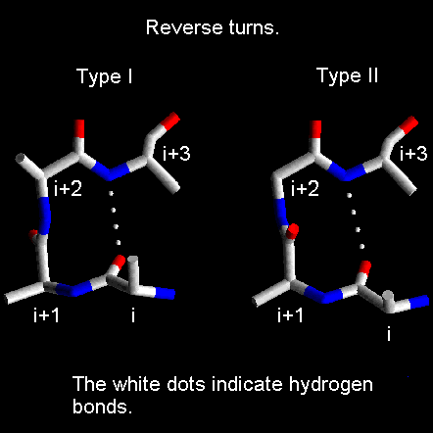
Loops and Turns
Loops: often contain hydrophilic residue on the surface of proteins
Turns: loops with less than 5 residues and often contain G, P

Slide 24
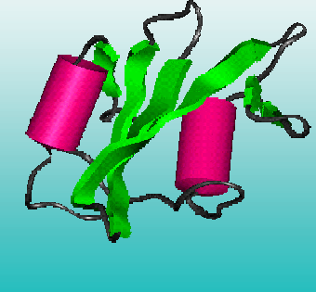
Tertiary structure
Packing the secondary structure elements into a compact spatial unit
“Fold” or domain– this is the level to which structure prediction is currently possible.

Slide 25
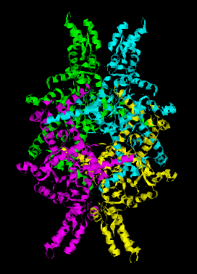
Quaternary structure
Assembly of homo or heteromeric protein chains.
Usually the functional unit of a protein, especially for enzymes

Slide 26
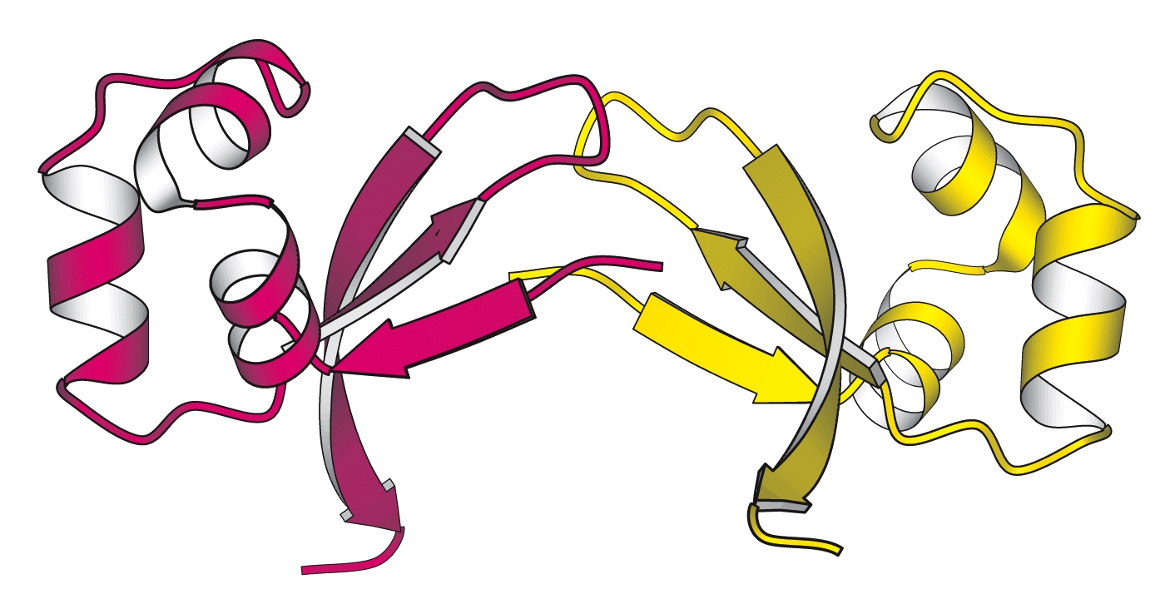

Slide 27
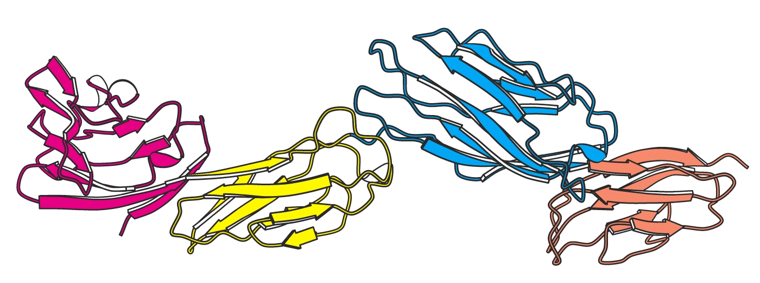

Slide 28
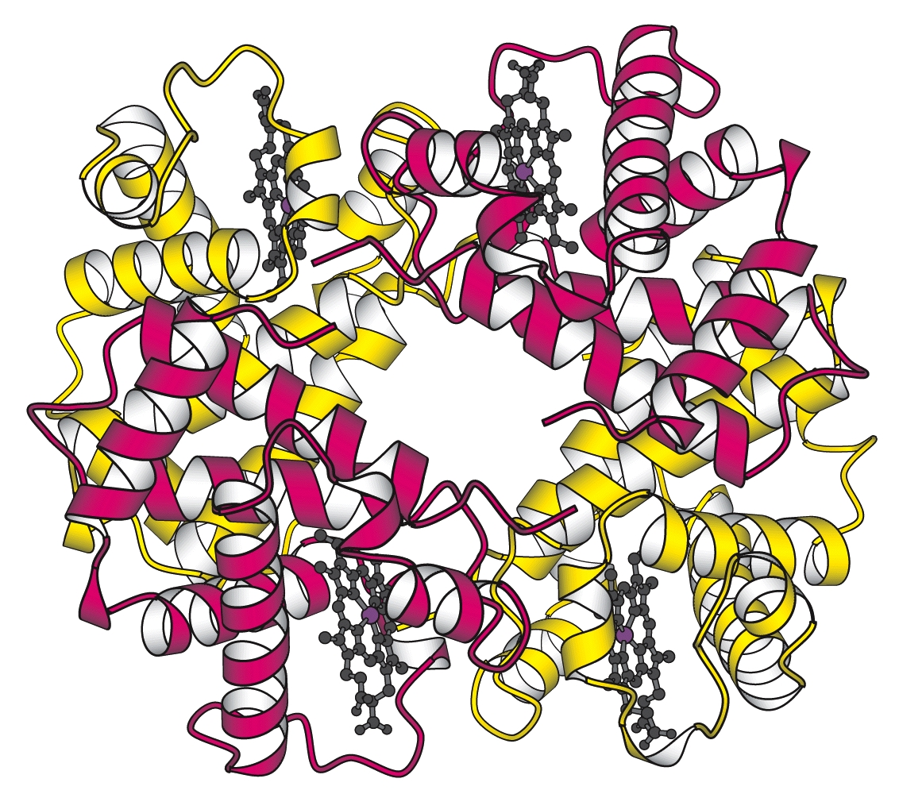

Slide 29
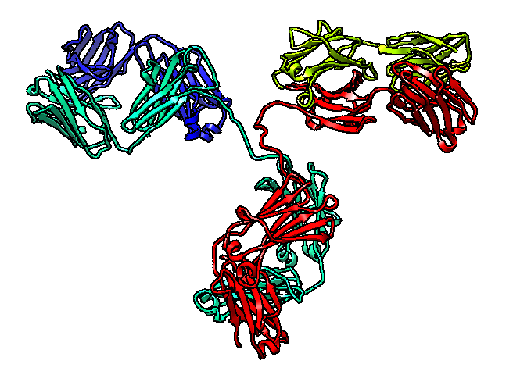
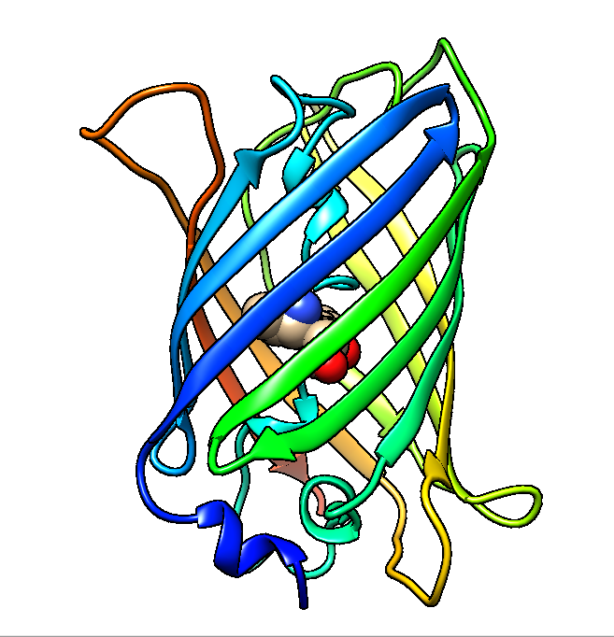
Protein Structure-Function: Vocabulary check
Protein structure:
Chain
Motif
Domain
Oligomer – dimer, trimer etc.
Protein function:
Binding
Catalysis
Regulation (switch on and off)
Structural support/stability

Slide 30
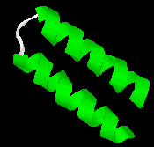
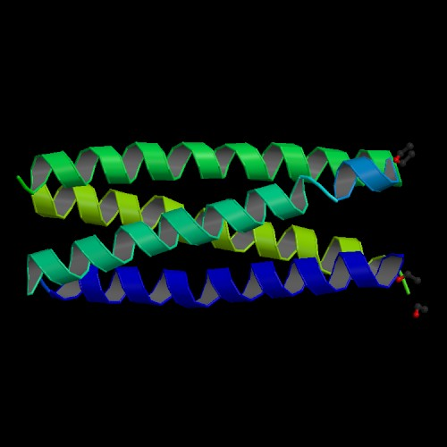
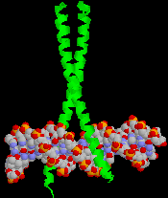
Motifs
Helix-loop-helix
Four helix bundle
Coiled coil

Slide 31
“structure” usually refers to
3-D structure of protein.

Slide 32
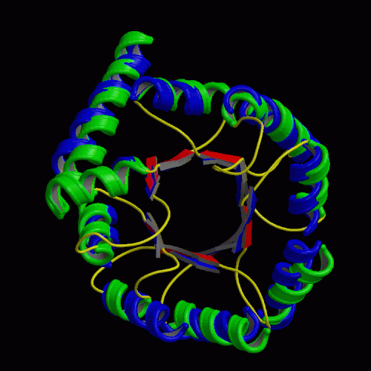
Structure is better conserved than sequence
Structure can adopt a
wide range of mutations.
Physical forces favor
certain structures.
Number of folds is limited.
Currently ~700
Total: 1,000 ~10,000 TIM barrel

Slide 33
Structural information
Protein Data Bank: maintained by the Research Collaboratory of Structural Bioinformatics(RCSB)
http://www.rcsb.org/pdb/
As of Sunday Sep 30, 2018 there are 144682 Structures
including structures of Protein/Nucleic Acid Complexes, Nucleic Acids, Carbohydrates
Each structure has a PDB ID: a 4 character unique identifier
Most structures are determined by X-ray crystallography (about 130000 entries). Some other methods are NMR (about 12000 entries) and electron microscopy(EM) (about 2500 entries). Theoretically predicted structures were removed from PDB a few years ago.

Slide 34
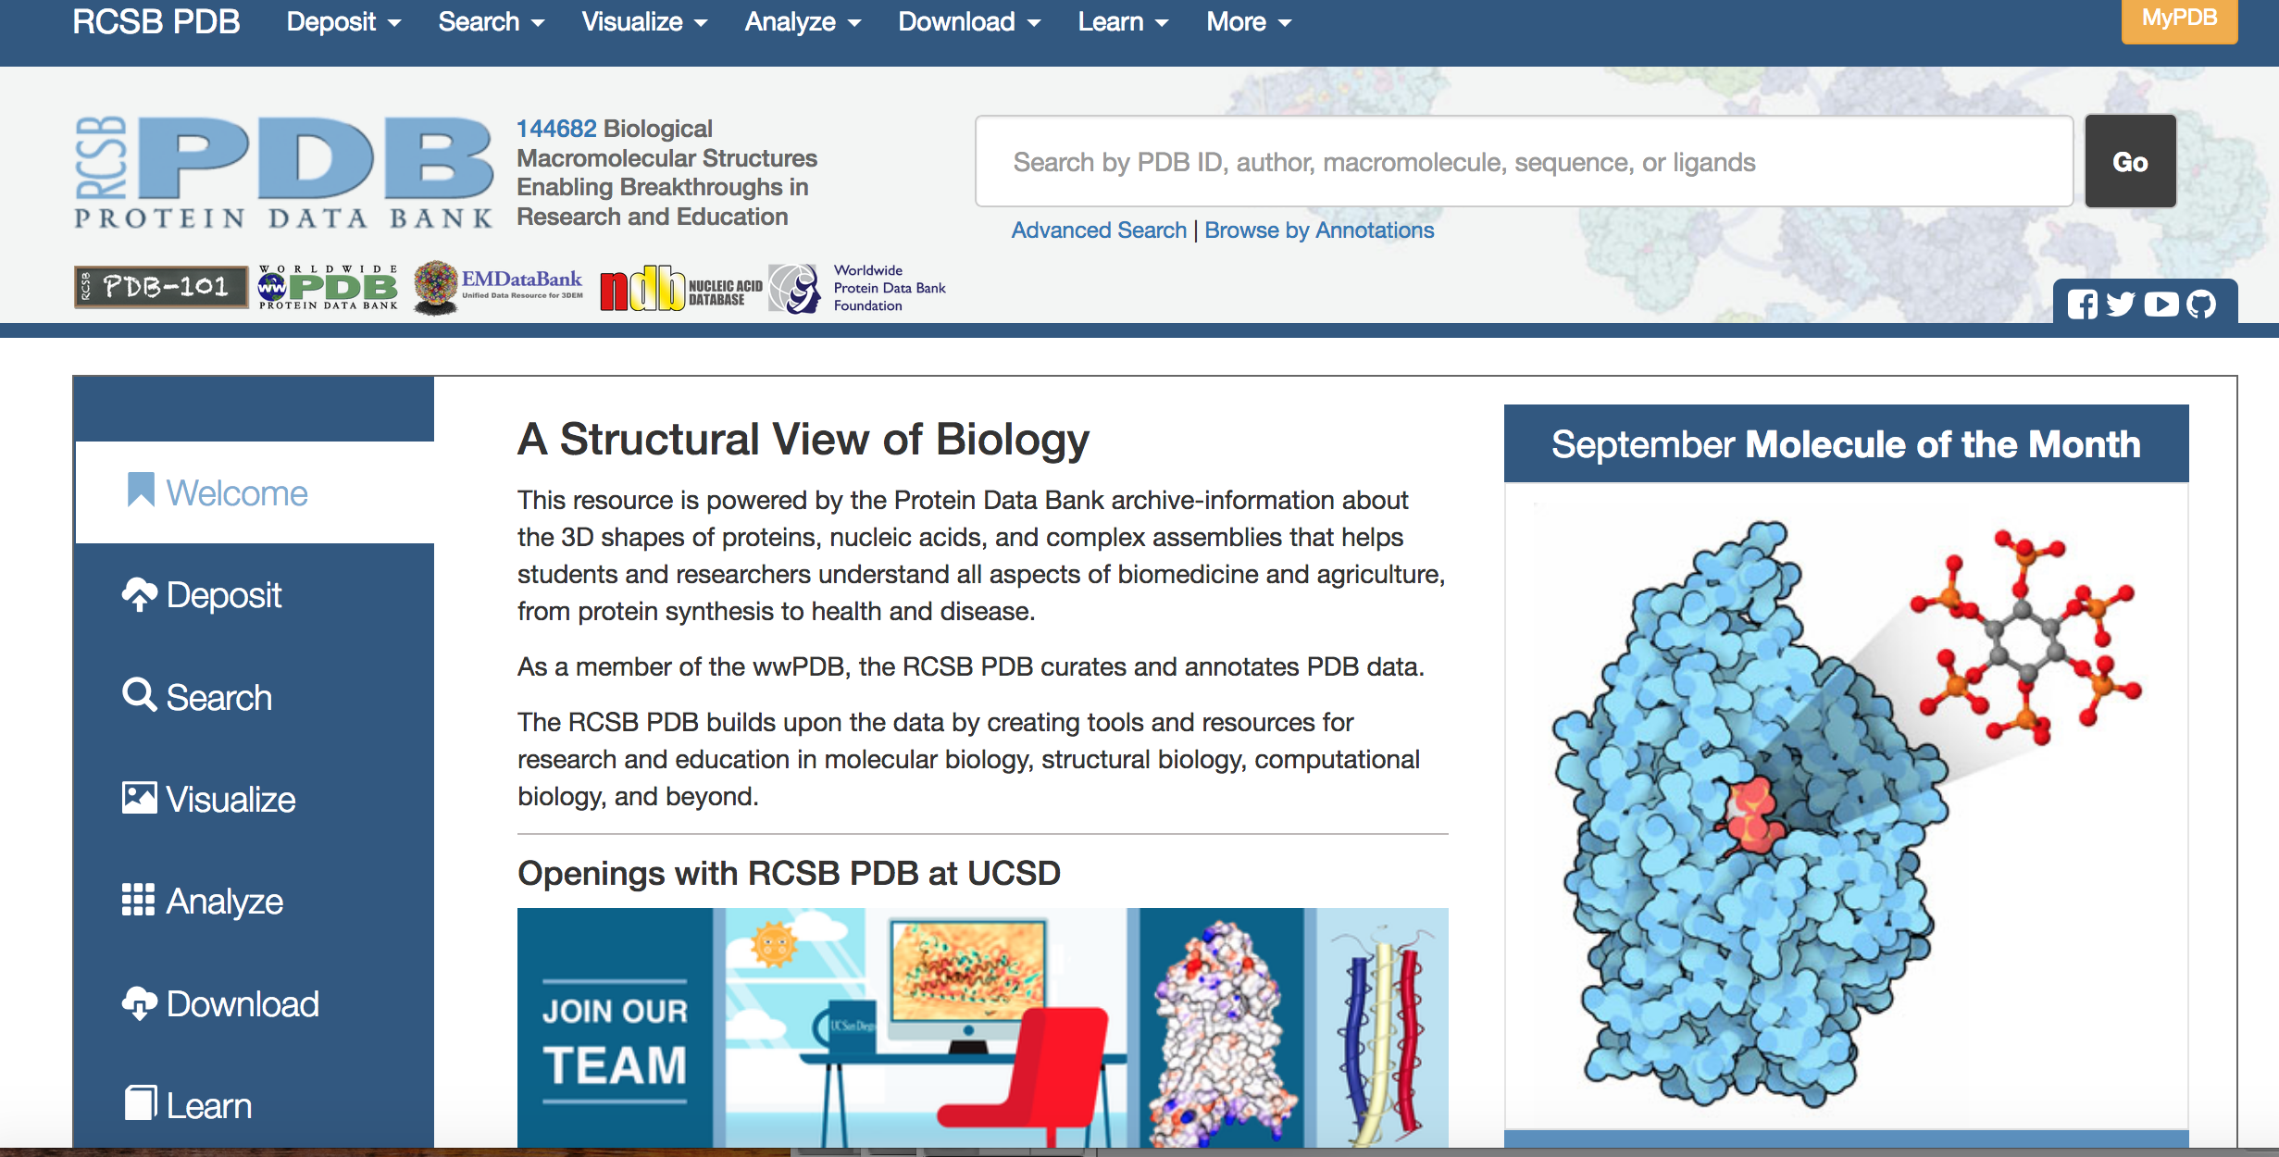
Structural information

Slide 35
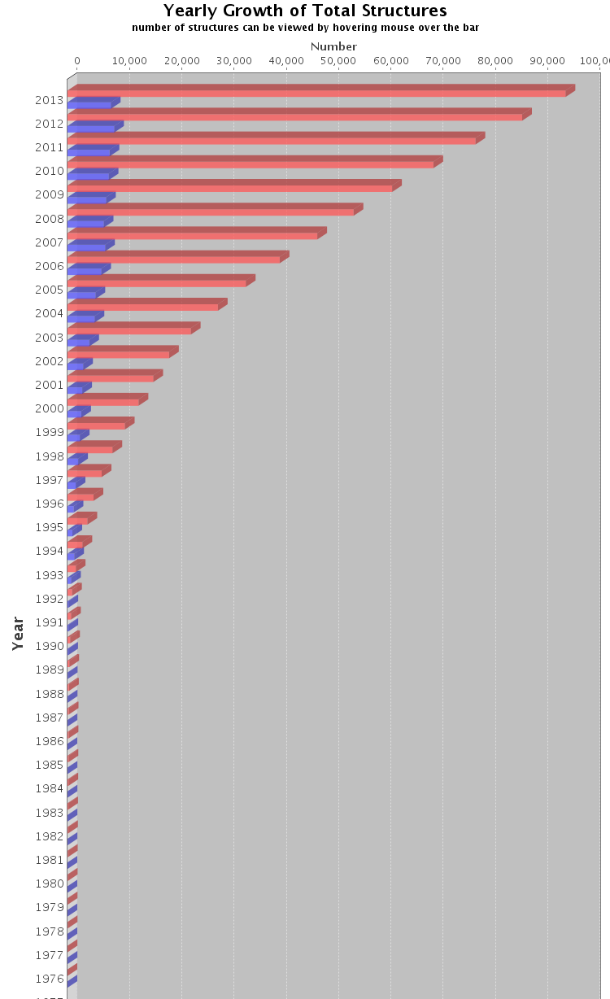
PDB Growth
Red: Total
Blue: Yearly

Slide 36
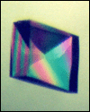
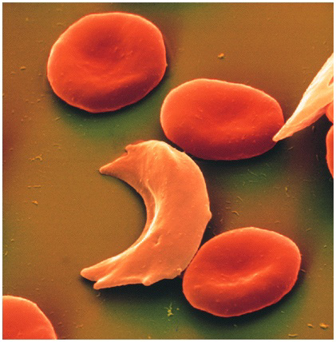

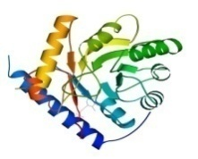
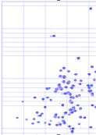
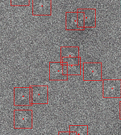


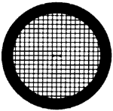

The Data Pipeline
Genomic
Based Target
Selection
Isolation,
Expression,
Purification,
Crystallization
Data
Collection
Structure
Determination
PDB Deposition
& Release
3D Models
Annotations
Publications
You come here
www.rcsb.org • info@rcsb.org

Slide 37
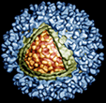
Experimental techniques for structure determination
X-ray Crystallography
Nuclear Magnetic Resonance spectroscopy (NMR)
Electron Microscopy/Diffraction
Free electron lasers ?

Slide 38
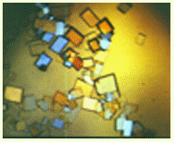
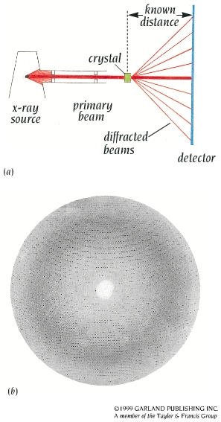
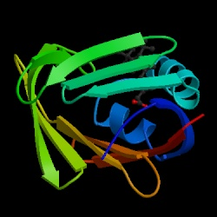
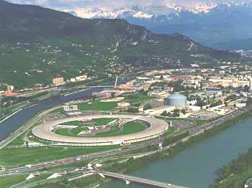
X-ray Crystallography

Slide 39
X-ray Crystallography..
From small molecules to viruses
Information about the positions of individual atoms
Limited information about dynamics
Requires crystals

Slide 40
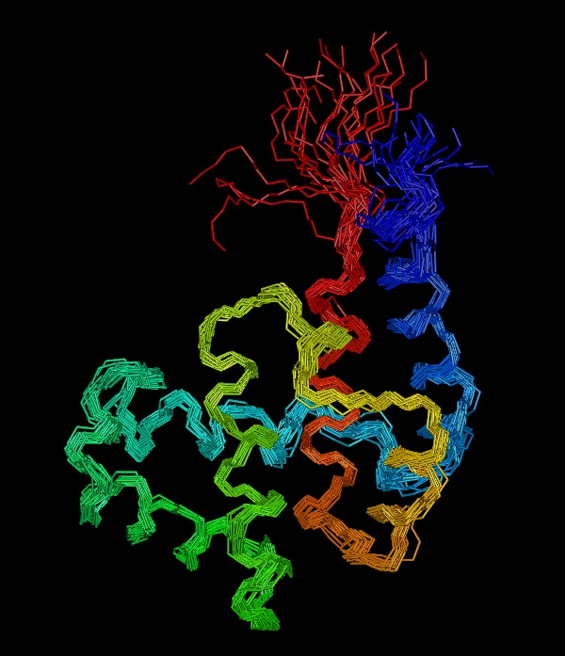
NMR
Limited to molecules up to ~50kDa (good quality up to 30 kDa)
Information about distances between pairs of atoms
A 2-d resonance spectrum with off-diagonal peaks
Requires soluble, non-aggregating material

Slide 41
What is in the PDB?
Coordinate and experimental data files
Details about sample preparation, data collection and structure solution
Sequence(s) of polymers (proteins and nucleic acids) in the structure
Information about ligands in the structure
Links to various resources that describe the sequence, function and other properties of the molecule.
Classification of structures by sequence, structure, function and other criteria
Download/Use directly
Link to/Find similar

Slide 42
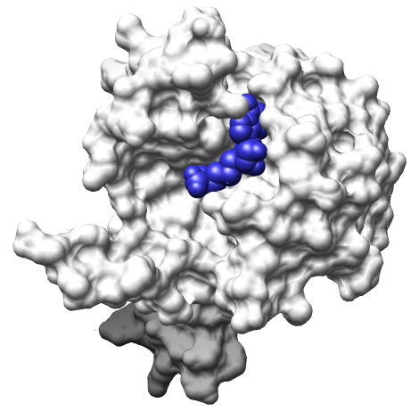
Protein 3D Structures
Investigating & visualizing protein structures
Structure – shape guides function
Binding pockets
PDB ID 1nw7

Slide 43
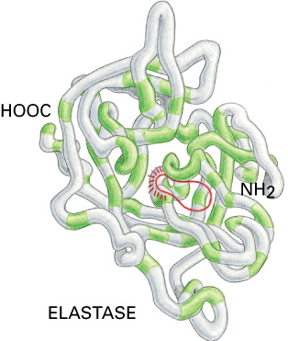
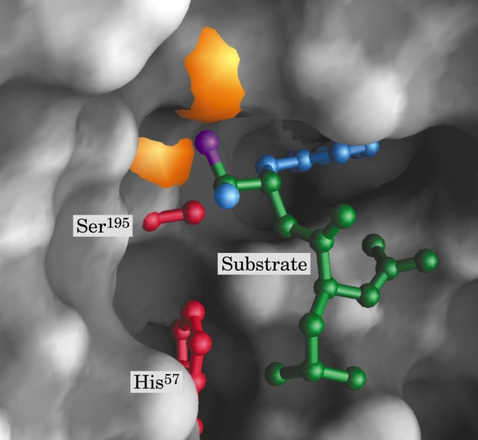
Protein 3D Structures
Investigating & visualizing protein structures
Structure – chemical properties guide function
Notes:
Ser-His-Glu (serine protease)

Slide 44
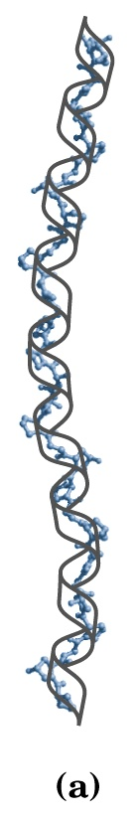
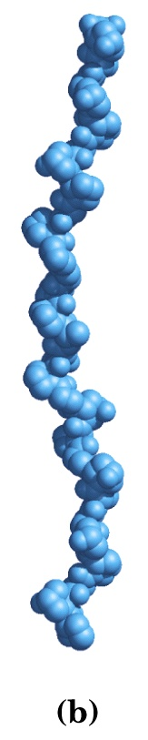



Protein 3D Structures
Investigating & visualizing protein structures
Structure – global fold guides function
Notes:
Location: mammalian connective tissues (tendons, cartilage, bone matrix, and the cornea of the eye)
Function: tensile strength (tendons, skin); stiffness (cartilage, bone)
Related pathologies: scurvy (vitamin C deficiency)
Structural characteristics of the polypeptide chain:
Length: ~1000 residues; ~3000Å
A trimer of left-handed helices: 3.3 residues per turn; 2.9Å rise per residue
Trimer width: ~14Å

Slide 45

Structure-Function Relationship
Certain level of function can be found without structure. But the structure is a key to understand the detailed mechanism.
structure is a powerful tool for function inference.
Trp repressor as a function switch

Slide 46

Structure-Based Drug Design
Structure-based rational drug design is a major method for drug discovery.
HIV protease inhibitor

Slide 47

Investigating & visualizing protein structures
Tertiary structure = protein fold
Structure is more conserved
Structure can be used to detect distant evolutionary relationships
Structure can give information on protein function
Structure can be used for drug design

Slide 48


Protein Folding Problem
A protein folds into a unique 3D structure under the physiological condition: determine this structure
Lysozyme sequence:
KVFGRCELAA AMKRHGLDNY
RGYSLGNWVC AAKFESNFNT
QATNRNTDGS TDYGILQINS
RWWCNDGRTP GSRNLCNIPC
SALLSSDITA SVNCAKKIVS
DGNGMNAWVA WRNRCKGTDV
QAWIRGCRL

Slide 49
Levinthal’s paradox
Consider a 100 residue protein. If each residue can take only 3 positions, there are 3¹⁰⁰ = 5 × 10⁴⁷ possible conformations.
If it takes 10⁻¹³s to convert from 1 structure to another, exhaustive search would take 1.6 × 10²⁷ years!
Folding must proceed by progressive stabilization of intermediates.

Slide 50
Forces driving protein folding
It is believed that hydrophobic collapse is a key driving force for protein folding
Hydrophobic core
Polar surface interacting with solvent
Minimum volume (no cavities)
Disulfide bond formation stabilizes
Hydrogen bonds
Polar and electrostatic interactions

Slide 51
Effect of a single mutation
Hemoglobin is the protein in red blood cells (erythrocytes) responsible for binding oxygen.
The mutation E→V in the β chain replaces a charged Glu by a hydrophobic Val on the surface of hemoglobin
The resulting “sticky patch” causes hemoglobin to agglutinate (stick together) and form fibers which deform the red blood cell and do not carry oxygen efficiently
Sickle cell anemia was the first identified molecular disease

Slide 52



Sickle Cell Anemia
Sequestering hydrophobic residues in the protein core protects proteins from hydrophobic agglutination.

Slide 53


Slide 54

Download structure
Display
structure
The paper describing
the structure

Slide 55
Investigating & visualizing protein structures
RCSB- The Protein Data Bank
TITLE
REMARK
COMPND
SEQRES- the original sequence
HELIX, BETA- secondary structure
ATOM – The actual protein/DNA/RNA chain
HETATM- additional atoms such as ligands, water etc.
…
PDB files have a specific format:

Slide 56
PDB Files: the “header”
HEADER OXIDOREDUCTASE(SUPEROXIDE ACCEPTOR) 13-JUL-94
COMPND MANGANESE SUPEROXIDE DISMUTASE (E.C.1.15.1.1) COMPLEXED
COMPND 2 WITH AZIDE
OURCE (THERMUS THERMOPHILUS, HB8)
AUTHOR M.S.LAH,M.DIXON,K.A.PATTRIDGE,W.C.STALLINGS,J.A.FEE,
AUTHOR 2 M.L.LUDWIG
REVDAT 2 15-MAY-95
REVDAT 1 15-OCT-94
JRNL AUTH M.S.LAH,M.DIXON,K.A.PATTRIDGE,W.C.STALLINGS,
JRNL AUTH 2 J.A.FEE,M.L.LUDWIG
JRNL TITL STRUCTURE-FUNCTION IN E. COLI IRON SUPEROXIDE
JRNL TITL 2 DISMUTASE: COMPARISONS WITH THE MANGANESE ENZYME
JRNL TITL 3 FROM T. THERMOPHILUS
JRNL REF TO BE PUBLISHED
REMARK 1 AUTH M.L.LUDWIG,A.L.METZGER,K.A.PATTRIDGE,W.C.STALLINGS
REMARK 1 TITL MANGANESE SUPEROXIDE DISMUTASE FROM THERMUS
REMARK 1 TITL 2 THERMOPHILUS. A STRUCTURAL MODEL REFINED AT 1.8
REMARK 1 TITL 3 ANGSTROMS RESOLUTION
REMARK 1 REF J.MOL.BIOL. V. 219 335 1991
REMARK 1 REFN ASTM JMOBAK UK ISSN 0022-2836
REMARK 1 REFERENCE 2
REMARK 1 AUTH W.C.STALLINGS,C.BULL,J.A.FEE,M.S.LAH,M.L.LUDWIG
REMARK 1 TITL IRON AND MANGANESE SUPEROXIDE DISMUTASES:
REMARK 1 TITL 2 CATALYTIC INFERENCES FROM THE STRUCTURES
JRNL- reference

Slide 57
PDB files - coordinates
Atom & Residue
ATOM 7 SD MET A 1 -29.059 28.614 71.539 1.00 26.90 S
ATOM 8 CE MET A 1 -27.535 29.074 70.866 1.00 16.57 C
ATOM 9 N ILE A 2 -29.656 32.903 69.094 1.00 25.93 N
ATOM 10 CA ILE A 2 -30.077 33.171 67.730 1.00 25.49 C
HETATM 3139 C6 SAH 328 -11.642 26.514 89.489 1.00 17.97 C
HETATM 3140 N6 SAH 328 -10.474 26.661 90.103 1.00 14.50 N
HETATM 3141 N1 SAH 328 -11.895 25.334 88.899 1.00 23.10 N
HETATM 3142 C2 SAH 328 -13.079 25.090 88.350 1.00 16.93 C
HETATM 3143 N3 SAH 328 -14.120 25.887 88.278 1.00 16.05 N
HETATM 3144 C4 SAH 328 -13.832 27.092 88.861 1.00 14.31 C
HETATM 3145 O HOH 329 -29.525 42.890 90.934 1.00 24.84 O
HETATM 3146 O HOH 330 -28.213 42.867 93.588 1.00 8.11 O
HETATM 3147 O HOH 331 -24.619 35.287 96.173 1.00 17.96 O
Atom
Number
Atom, residue
or molecule
Coordinates: X, Y, Z
Chain
http://www.wwpdb.org/documentation/format3.1-20080211.pdf

Slide 58

Growth of unique folds (topologies) per year
Number of folds is limited.
Currently ~700
Total: 1,000 ~10,000

Slide 59

(a) myoglobin (b) hemoglobin (c) lysozyme (d) transfer RNA
(e) antibodies (f) viruses (g) actin (h) the nucleosome
(i) myosin (j) ribosome
Courtesy of David Goodsell, TSRI

Slide 60
Protein structure databases
PDB
3D structures
SCOP
Murzin, Brenner, Hubbard, Chothia
Classification
Class (mostly alpha, mostly beta, alpha/beta (interspersed), alpha+beta (segregated), multi-domain, membrane)
Fold (similar structure)
Superfamily (homology, distant sequence similarity)
Family (homology and close sequence similarity)

Slide 61
The SCOP Database
Structural Classification Of Proteins
FAMILY: proteins that are >30% similar, or >15% similar and have similar known structure/function
SUPERFAMILY: proteins whose families have some sequence and function/structure similarity suggesting a common evolutionary origin
COMMON FOLD: superfamilies that have same secondary structures in same arrangement
CLASS: alpha, beta, alpha–beta, alpha+beta, multidomain

Slide 62
Protein databases
CATH
Orengo et al
Class (alpha, beta, alpha/beta, few SSEs)
Architecture (orientation of SSEs but ignoring connectivity)
Topology (orientation and connectivity, based on SSAP = fold of SCOP)
Homology (sequence similarity = superfamily of SCOP)
S level (high sequence similarity = family of SCOP)
SSAP alignment tool (dynamic programming)

Slide 63
Some databases/tools
PubMed—PubMed contains more than 23 million abstracts for biomedical literature from MEDLINE, life science journals, and online books.
https://www.ncbi.nlm.nih.gov/pubmed/
dbSNP—The Single Nucleotide Polymorphism Database (dbSNP) is an archive for genetic variation within and across different species developed and hosted by National Center for Biotechnology Information (NCBI) in collaboration with National Human Genome Research Institute (NHGRI). The database contains information about SNPs, short deletion and insertional polymorphisms (indels/DIPs), microsatellite markers and short tandem repeats (STRs), multi nucleotide Polymorphisms (MNPs), heterozygous Sequences, and named variants.
https://www.ncbi.nlm.nih.gov/projects/SNP/
NCBI Variation Viewer - Variation Viewer allows you to view, search, and navigate variations in genomic context. You can review data from dbSNP, dbVar and ClinVar, or upload your own data.
https://www.ncbi.nlm.nih.gov/variation/view/overview/

Slide 64
Proteins must
Fold correctly
Be stable (but not too stable)
Bind to other proteins or ligands in the cell
Have a functional catalytic site
Assemble correctly (oligomerization)

Slide 65
How does variation affect proteins?
Activity—The variation causes increase, decrease, or complete loss of protein activity
Src kinase – mutant is constitutively active
Aggregation—Variation renders the protein aggregation prone
Cystatin, Cu, Zn superoxide dismutase
Stability—Variation may make the protein susceptible to proteolytic cleavage, or cause a change in thermal inactivation temperature, or cause a change in the energy of stabilization of the protein. It can also lead to destabilization of a protein oligomer, loss of packing or hydrophobic interactions, or change a mode(s) of protein-protein interaction.
DJ-1
Binding/Dissociation–changes in affinity for a known binding partner, or alterations in association or dissociation kinetics. It can also cause structural changes in the binding site or affect specificity for a binding partner(s).
Ras
Assembly—The SNV affects the oligomeric assembly properties of the protein.
arylsulfatase A, DJ-1
Rearrangement—Variation causes conformational changes in the neighborhood of the mutation.
Abl kinase, von Willebrand factor

Slide 66


Examples for each SNV related effect category.
Bhattacharya R, Rose PW, Burley SK, Prlić A (2017) Impact of genetic variation on three dimensional structure and function of proteins. PLOS ONE 12(3): e0171355. https://doi.org/10.1371/journal.pone.0171355
https://journals.plos.org/plosone/article?id=10.1371/journal.pone.0171355

Slide 67
Activity
Download the following papers
Bhattacharya R, Rose PW, Burley SK, Prlić A (2017) Impact of genetic variation on three dimensional structure and function of proteins. PLOS ONE 12(3): e0171355. https://doi.org/10.1371/journal.pone.0171355
https://journals.plos.org/plosone/article?id=10.1371/journal.pone.0171355
Zehir, A., Benayed, R., Shah, R. H., Syed, A., Middha, S., Kim, H. R., et al. (2017). Mutational landscape of metastatic cancer revealed from prospective clinical sequencing of 10,000 patients. Nature Medicine, 23(6), 703–713. http://doi.org/10.1038/nm.4333
Quickly read through the papers and answer the following questions about the papers.
What is the biological question?
What is the method?
What significant scientific contribution does the paper make?
We will go over these papers in more detail soon.

Slide 68
Activity
Go through the papers and identify one protein whose mutation (remember we focus on missense mutations) is associated with a disease state.
Go to the PDB and search for the protein using its name.
Give a brief summary of the available information in the PDB:
How many entries are there for this protein?
Which method(s) were used in characterization of the structure?
For the most recent entry with a publication record:
What is the structure determination method?
What is the Uniprot ID?
How many chains does it have?
What is the sequence length?
Which ligands (if any) are present?
Examine the 3D structure using 3D view. Color by chain.
Play with all of the options and prepare a structure figure.

